Slide 1
Machine Learning in Medical Imaging

Slide 2
What is Machine Learning?
Field of study that gives computers the ability to learn without being explicitly programmed.¹ (Arthur Samuel, 1959)
A computer program is said to learn from experience E with respect to some task T and some performance P, if its performance on T, as measured by P, improves with experience E.² (Tom Mitchell, 1998)

Slide 3

1950 –––– Alan Turing proposed the Turing testing for the machine’s ability to think.³
1952 –––– Arthur Samuel created the first machine learning programs that play checkers. He later coined the term “machine learning” in 1959.⁴
1957 –––– Frank Rosenblatt invented the perceptron, with resemblance to a simple biological neuron. It later became the building blocks of future neural networks.⁵
1989 –––– David Rumelhart, Geoff Hinton and Ronald J. Williams described backpropagation, a core method used in deep neural networks.⁶
1995 –––– Corinna Cortes and Vladimir Vapnik developed support vector machines.⁷
1997 –––– IBM's Deep Blue beats the world champion at chess.
1998 –––– LeCun et al. developed LeNet-5, a pioneering convolutional network.⁸
2009 –––– ImageNet, a large image database that boomed AI research in the 21st century, was created.
2012 –––– AlexNet by Krizhevsky et.al from Toronto became the first convolutional neural network (CNN) that won the ImageNet competition.⁹
2016 –––– Google’s AlphaGo beat professional human players on GO.
Image source: https://www.amazon.com/Brief-History-Time-Soundtrack/dp/B00TYDKGNU

Slide 4
Types of machine learning
Supervised learning
Classification problem
Binary classification
Multi-class classification
Input and output (label) provided
Machine learns the relationship between the input and the label from the training set and makes predictions on the test set based on that learned relationship.

Slide 5
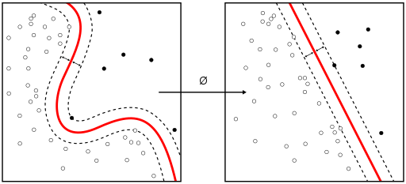
Types of machine learning
Supervised learning
Example algorithms:
Linear Regression
Naïve Bayes Classifier
Decision Trees
Nearest Neighbor
Convolutional Neural Network (CNN)
Image source: https://en.wikipedia.org/wiki/Supervised_learning#/media/File:Kernel_Machine.svg

Slide 6
Types of machine learning
Unsupervised learning
Clustering problem
Only data provided, with no labels
Machine learns the underlying structure of data and can group them accordingly, even generate new samples from the same distribution.

Slide 7
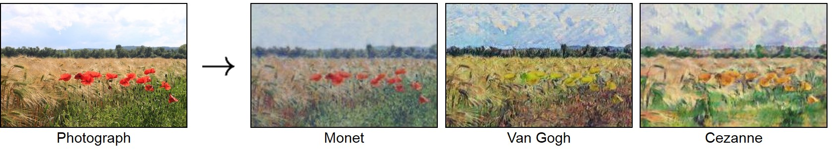
Types of machine learning
Unsupervised learning
Example algorithms:
K-means Clustering
Hierarchical Clustering
Generative Adversarial Networks (GANs)
Image source: https://github.com/junyanz/CycleGAN

Slide 8
Convolutional Neural Network (CNN)
A class of deep, feed-forward neural network
Consists of multiple layers of “neurons”
Input layer
Hidden layers
Convolutional layer
Activation layer
Pooling layer
Fully connected layer
Loss layer
Output layer

Slide 9
Convolutional Neural Network (CNN)
Most commonly used in analyzing images.
An image can be seen as a D*H*N matrix of pixel values with D,H being the width and height of the image and N being the number of color channels (ex. three for RGB images and one for grayscale images).
CNN is essentially recognizing the visual elements and features of the image.

Slide 10
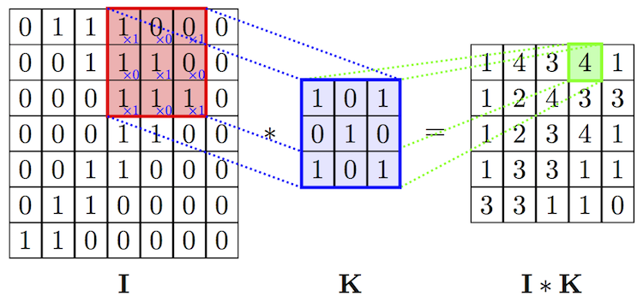
CNN Architecture
Convolutional layer
Slide a filter (of smaller width and height but the same depth as the input) of weights across the input matrix to produce a feature map.
Use different filters on the same input to obtain a set of feature maps (depth equals the number of filters used) to be the output.
Convolution here is a mathematical operation that takes the dot product of the filter and a small chunk of the input of the same size.
Image source: https://cambridgespark.com/content/tutorials/convolutional-neural-networks-with-keras/index.html

Slide 11
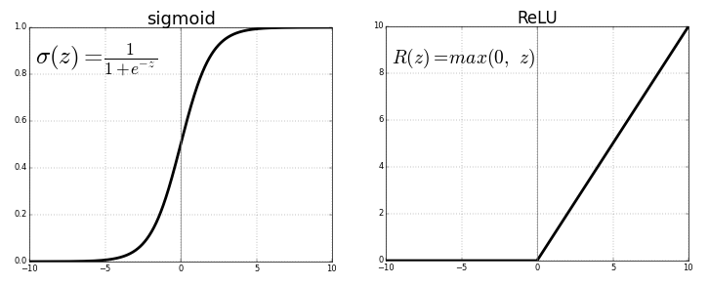
CNN Architecture
Activation layer
Introduce non-linearity to the output.
Decides if a “neuron” should fire (“1”) or not (“0”)
Different types of activation functions:
ReLU — f(x) = max(0, x)
Sigmoid — f(x) = 1/(1+e^{-x})
Image source: https://towardsdatascience.com/activation-functions-neural-networks-1cbd9f8d91d6

Slide 12
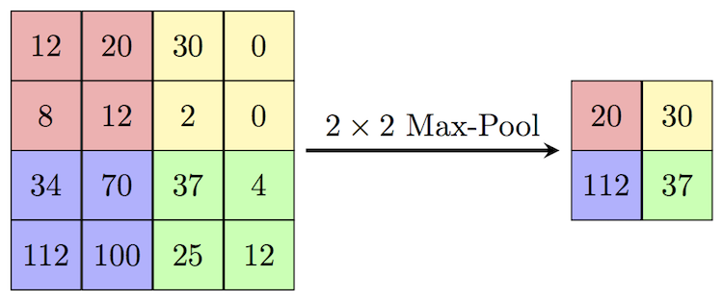
CNN Architecture
Pooling layer
Non-linear down-sampling as a way to combat overfitting
Partition the image to non-overlapping regions and use one value to represent the entire region.
Common methods
Max pooling: use the maximum value of the region.
Global average pooling: use the average value of the region.
Image source: https://computersciencewiki.org/index.php/Max-pooling_/_Pooling

Slide 13
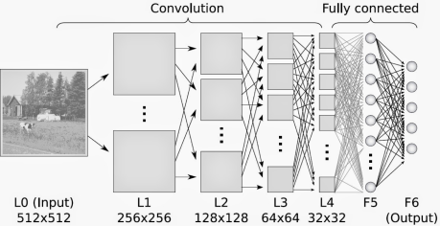
CNN Architecture
Fully connected layer
“Neurons” in this layer have access to all activations in the previous layer.
High level reasoning that gives a final output usually at the end of CNN for loss computation.
Image source: https://qph.fs.quoracdn.net/main-qimg-cc30aa65a662315c3c22e405722c4109.webp

Slide 14
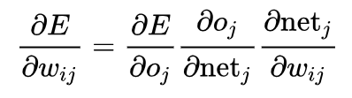
CNN Architecture
Loss layer
Loss is described by a function that penalizes the deviation between predictions and true labels.
Common loss functions:
L2 loss: L_{i} = 1/2(y_{i} – y)²
Cross entropy loss: L_{i} = -log(P_{i})
Uses the gradients of the loss to optimize the weights in each layer to obtain the lowest loss.
Gradient is the partial derivative of the loss with respect to each individual weight.
Update weights in the negative direction of the gradient.
Gradients calculated through backpropagation using the chain rule.

Slide 15
Machine learning in medical imaging
Why machine learning?
Overwhelming number of images but very few trained radiologists to read them.
Radiology tasks are very suited for machine learning algorithms
Input and labels are provided for supervised learning.
A large amount of training images are potentially available for data hungry algorithms such as CNN.
Increasing computing power allows for more complex analysis of medical images.

Slide 16
Machine learning in medical imaging
Various applications¹⁰
Improve diagnostics
Obtain human-level accuracy with far more efficiency.
Prioritize work lists
More severe cases can be directed to the radiologist’s attention first.
Counter observer fatigue
Radiomics
Extract information from the images not apparent to naked eyes that could be predictive for prognosis and therapeutic response.

Slide 17
Machine learning in medical imaging
Endpoints
For patients:
Increase in diagnostic accuracy
Discovery of new knowledge and extraction of more and better information from image examinations
Ultimately improvement of outcomes for patients
For radiologists and institutions
Establishment of more efficient work processes
Improvement of job satisfaction for radiologists

Slide 18
Machine learning in medical imaging
Opportunities and needs
Image sharing networks
A large network of sharing data needs to be established
Ex. The American College of Radiology Imaging Network (ACRIN)¹¹, The Cancer Imaging Archive (TCIA) ¹²
Reference database for training and testing
A public reference database similar to the “ImageNet” of images would be valuable for machine learning researches.
Standardization of imaging protocol
Medical image qualities are prone to the variable imaging protocols and the execution of such, which can be an impediment to machine learning research.

Slide 19
Machine learning in medical imaging
Challenges and concerns
Failure to assemble a dataset with sufficient amount of images
Intrinsic challenges:
How to establish the ground truth?
Definition of “normal” vs “abnormal”
Tolerance of algorithms towards different patient populations and different imaging protocols.
Adult vs Children
Different ethnicity groups
Liability and legal issues
Who will be responsible?
How to validate AI programs?

Slide 20
Machine learning in medical imaging
Past and current attempts
Automatic segmentation¹⁴
To isolate and analyze organs or pathologic lesions
Radiomics¹³
Correlation between imaging appearance and the genomics of the disease
Computer aided diagnosis system (CAD)¹⁴
Combines feature-based data extraction and rule-based inference to give differential diagnosis
However, generated many false positives.

Slide 21
Machine learning in medical imaging
Past and current attempts
Data-driven patient similarity clinical decision support¹⁵
Search the database for prediagnosed patients with clinical similarities and generate a statistically ranked list of diagnosis, outcomes, etc.
Cognitive assistants¹⁶
Ex. IBM’s “Eyes of Watson”
Models a radiologist’s diagnosis process
Combines modality/mode recognition, body position recognition, anatomy segmentation, anomaly detection and disease knowledge using numerous trained deep-learning networks.

Slide 22
Machine learning in medical imaging
Future: will machine learning……
Replace?
“Machine learning will become a powerful force in the next 5-10 years and could end radiology as a thriving specialty.” –––– Chockley and Emanuel, JACR¹⁷.
Or benefit?
Medical images are highly heterogeneous and biology is very complex.
Radiologists will likely benefit from AI assistance programs rather than being replaced.
Regardless, the end goal is to improve patient outcome.

Slide 23
References
Samuel AL. Some Studies in Machine Learning Using the Game of Checkers. IBM Journal of Research and Development. 1959;3(3): 210.
Mitchell T. Machine Learning. McGraw Hill. 1997; p. 2.
Turing AM. Computing Machinery and Intelligence. Mind. 1950;59(236): 446-447.
McCarthy J, Feigenbaum E. Arthur Samuel: Pioneer in Machine Learning. AI Magazine. 1990;11(3): 10.
Rosenblatt F. The perceptron: A probabilistic model for information storage and organization in the brain. Psychological Review. 1958;65 (6): 386–408.
Rumelhart D, Hinton G, Williams R. Learning representations by back-propagating errors. Nature. 1986;323: 533–536.
Cortes, C Vapnik, V. Support-vector networks. Machine Learning. Kluwer Academic Publishers. 1995;20 (3): 273–297.
LeCun, Yann; Léon Bottou; Yoshua Bengio; Patrick Haffner. Gradient-based learning applied to document recognition. Proceedings of the IEEE. 1998;86 (11): 2278–2324.
Krizhevsky A, Sutskever I, Hinton G. ImageNet classification with deep convolutional neural networks. Proceedings of the NIPS. 2012;1: 1097–1105.
Thrall JH et, et al. Artificial Intelligence and machine learning in radiology: opportunities, challenges, pitfalls, and criteria for success. J Am Coll Radiol. 2017;15: 504-508.
Hillman BJ. The American College of Radiology Imaging Network and the mission of radiologists. Radiology. 2002;223(3): 602.
Clark K, et al. The Cancer Imaging Archive (TCIA): maintaining and operating a public information repository . Journal of Digital Imaging. 2016;26: 1045-1057.
Gillies RJ, Kinahan PE, Hricak H. Radiomics: images are more than pictures, they are data. Radiology. 2015;278: 563-77.
King BF. Artificial intelligence and radiology: what will the future hold? J Am Coll Radiol. 2017;15(3): 501-503.
Castellino RA. Computer aided detection (CAD): an overview. Cancer Imaging 2005;5:17-9.
Syeda-Mahmood T. Role of big data and machine learning in diagnostic decision support in radiology. J Am Coll Radiol. 2018;15: 569-576.
Chockley K, Emanuel E. The end of radiology? Three threats to the future practice of radiology. J Am Coll Radiol 2016;13:1415-20.

